Slide 1
GREEN JOBS AND SKILLS ASSESSMENT: KAZAKHSTAN
Prof. Alberto Frigerio – Almaty Management University
Email: f.alberto@almau.edu.kz

Slide 2
THE INTERCONNECTED PATH TO SUSTAINABILITY
GREEN JOBS
GREEN SKILLS
GREEN TRANSITION
CIRCULAR ECONOMY
The process of shifting from traditional, resource-intensive practices to sustainable and environmentally friendly alternatives.
A model that emphasizes the reuse, recycling, and repurposing of resources to minimize waste and environmental impact.
Knowledge, abilities, and values that contribute to the sustainability of economic activities and the integration of green technologies and processes into diverse professional settings.
Jobs in any economic sector that contribute to preserving, restoring, and enhancing environmental quality and/or support the development of sustainable practices.

Slide 3
GREEN JOBS: ESTIMATED DATA BY ILO
1.2 billion jobs will only be preserved by supporting a stable and healthy environment
The transition to a circular economy will generate 6 million new jobs
Achieving the Paris Agreement will result in 18 million more jobs
There is a risk of job displacement, green skill gaps, supply chain disruptions, and an exacerbation of social inequality

Slide 4
ORGANIZATIONAL STRUCTURE OF THE PROJECT
GREEN TRANSITION FRAMEWORK
- LEGAL AND POLICY MEASURES
- GREEN BUSINESS TRENDS
- CHALLENGES AND RECOMMENDATIONS
GREEN JOB MARKET ANALYSIS
- STATE OF GREEN EMPLOYMENT
- JOB TYPES AND RELATED GREEN SKILLS
- CHALLENGES AND RECOMMENDATIONS
EDUCATION AND GREEN SKILLS
- GREEN EDUCATIONAL AND TRAINING PROGRAMS
- GAPS AND BARRIERS
- ACTION PLAN TO FOSTER GREEN SKILLS

Slide 5
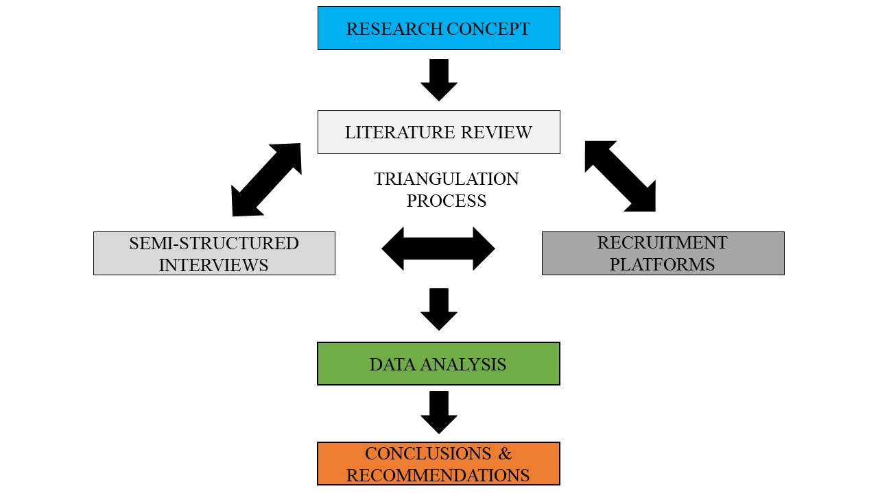
METHODOLOGICAL APPROACH

Slide 6
LIST OF INTERVIEWED SPECIALISTS: KAZAKHSTAN
ANNEX 1. RESPONDENTS TO THE SEMI-STRUCTURED INTERVIEWS
ACADEMIA
NAME AND SURNAME | UNIVERSITY | FOCUS AREA
Aurora Diaz Soloaga | Almaty Management University | Management Education Sustainability
Maiya Suyunchalieva | Kazakh National Agrarian University | Agriculture Innovation Sustainability
Larissa Kogutenko | Kazakh-German University | Water management Hydrometeorology Sustainability
Gulzhanat Gafu | Nazarbayev University | Ethics Education Sustainability
BUSINESS
NAME AND SURNAME | INSTITUTION | FOCUS AREA
Dmitriy Pak | EPAM Systems | ESG Social impact and inclusion Sustainability
Dana Shukirbayeva | Forest Hero | Climate tech Green entrepreneurship ESG consulting
Nailya Mussayeva | Green Academy (part-time consultant) | Consultancy Business development Sustainability
Danara Mukasheva | Qazaq Green Association | Project Management Education Renewable Energy Sources

Slide 7
LEGAL AND POLICY FRAMEWORK: KAZAKHSTAN
Law on Support for the Use of Renewable Energy (2009)
Law On Energy Saving and Increased of Energy Efficiency (2012)
New Environmental Code (2021)
Economic & financial support mechanisms
National projects
Bilateral agreements
Collaboration with international organizations
Special events and ad hoc institutions
Strategy Kazakhstan-2050 (2012)
Concept for the Transition to a Green Economy (2013)
Doctrine for Achieving Carbon Neutrality until 2060 (2021)

Slide 8
EMERGING GREEN BUSINESS AREA IN KAZAKHSTAN
Climate change and carbon reduction
Renewable energies and energy efficiency
Sustainable water management
Agroecological transformation
Green entrepreneurship
Natural resources management
Green finance
Sustainability audit
Green construction
Integrated planning and policy making

Slide 9
CHALLENGES AND RECOMMENDATIONS FOR THE GREEN TRANSITION PROCESS IN KAZAKHSTAN
Political and regulatory barriers
Gaps in the governance structure
Recommendations
Support for R&D
Regulations lack of clarity and comprehensiveness
Taxes on environmentally harmful activities
Adjust state purchase policy
Economic barriers
High subsidies for traditional energy sources
Recommendations
Financing mechanisms for green initiatives
Ensure state investments in infrastructure
Inadequate incentives for investors
Adjust pricing mechanisms
Electricity low prices
Technological challenges
High initial investment costs
Recommendations
Invest in training green specialists
Lack of expertise
Inadequate infrastructure
Support innovative green projects
Focus on green technology development

Slide 10
CHALLENGES AND RECOMMENDATIONS FOR THE GREEN TRANSITION PROCESS IN KAZAKHSTAN
Socio-cultural and educational factors
Limited public awareness
Recommendations
Need for capacity-building programs
Enhance communication strategies
Introduce green principles since childhood
Resistance to change
Skills gap
Infrastructure and supply chain constraints
Inefficient use of resources
Recommendations
Support for R&D
Inadequate tariffs
Low availability and accessibility to green sources
Address inefficiencies in resource use
Reform the tariff system
Financial and investment challenges
Lack of financial resources for modernization
Recommendations
Need for a clear and transparent framework
Limited access to green financing
Limited availability of green financial products
Increase awareness of green financing
Information coverage and training programs

Slide 11
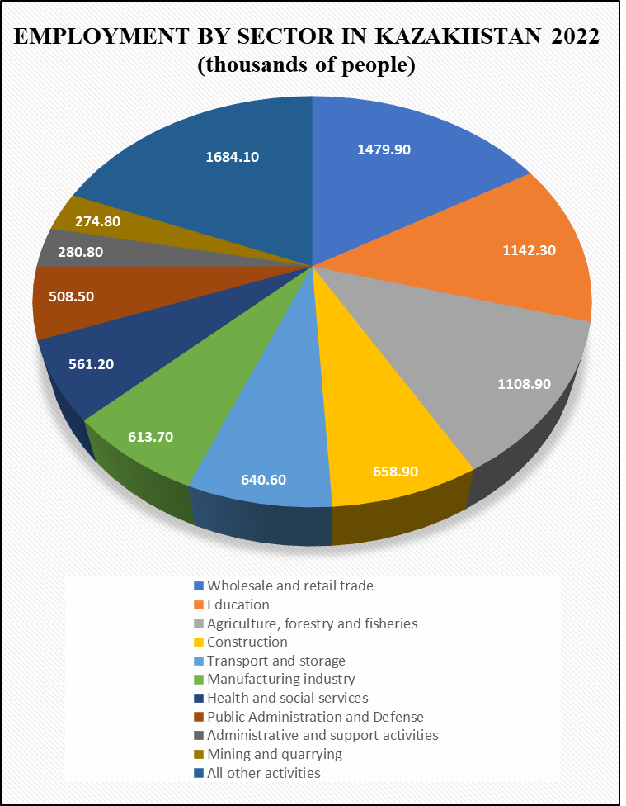
GREEN JOB MARKET IN KAZAKHSTAN
According to the data of the Bureau of National Statistics of Kazakhstan (2023), in the year 2022 around 48,895 people worked for medium-sized enterprises in “green jobs” aimed at preserving and restoring the environment. Other 8,608 people worked on similar functions but for small enterprises.
LACK OF STATISTICAL DATA

Slide 12
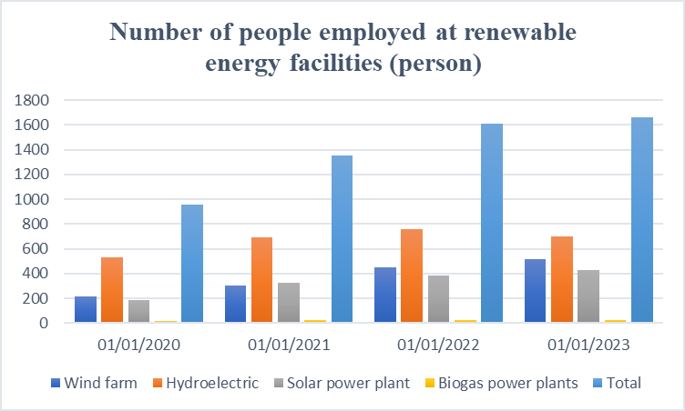
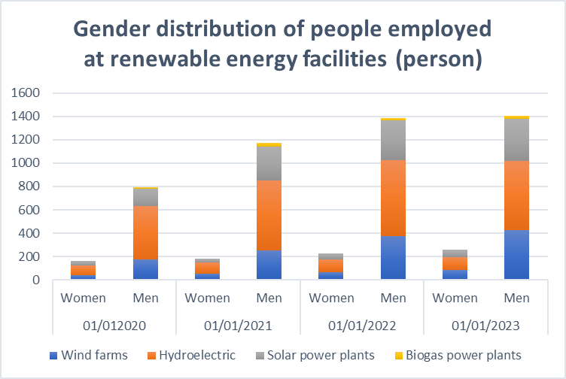
GREEN JOB MARKET IN KAZAKHSTAN
Hydroelectric is still the renewable energy sector with the largest employment. However, the number of people employed in wind farms and solar power plants is growing.
The number of men employed in this sector is approximately 6 times higher than the number of women. But the number of women employed in renewable energy facilities has grown by almost 60% from 2020 to 2023 and in 2023 more women have been hired in renewable energy facilities than men.

Slide 13
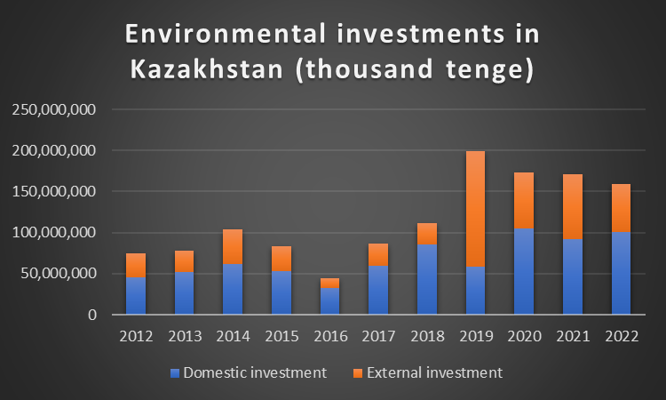
ENVIRONMENTAL INVESTMENTS IN KAZAKHSTAN
RENEWABLE ENERGY
WASTEWATER TREATMENT
AIR PROTECTION & CLIMATE CHANGE

Slide 14
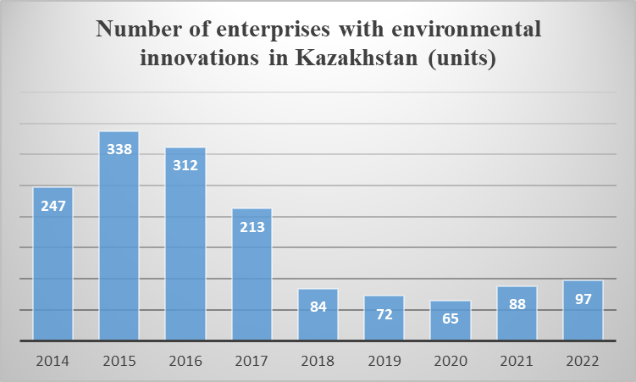
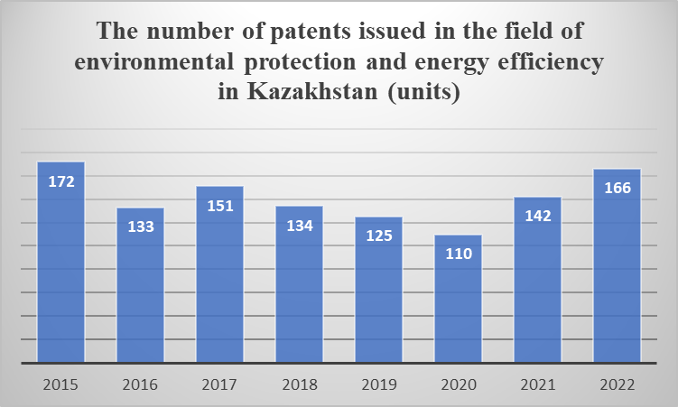
ENVIRONMENTAL INNOVATION AND PATENTS IN KAZAKHSTAN
Green innovation has regained a positive trend after 2020

Slide 15
GREEN JOB MARKET IN KAZAKHSTAN: RECRUITING PLATFORMS & SPECIALISTS
RECRUITING PLATFORMS: TOP 5 BUSINESS AREAS HIRING GREEN SPECIALISTS
Environmental and Climate Change
Engineering and Technology (Energy)
INTERVIEW RESPONDENTS: TOP 5 REQUESTED GREEN SPECIALISTS
Green Tech Specialists
Sustainability Consultants and Auditors
Agriculture and Water Resources
Safety and Compliance
Business and Finance
Specialized Managers
Green Analysts
Green Policy Makers

Slide 16
GREEN SKILLS IN KAZAKHSTAN: RECRUITING PLATFORMS & SPECIALISTS
MOST COMMON GREEN SKILLS IN RECRUITING PLATFORMS
NATURAL RESOURCE MANAGEMENT
ENVIRONMENTAL LAW
ENVIRONMENTAL ECONOMICS
CLIMATE
CHANGE
ENVIRONMENTAL MANAGEMENT
WATER RESOURCE MANAGEMENT
RENEWABLE ENERGY
MOST COMMON GREEN SKILL CONSIDERING BOTH SOURCES
ENVIRONMENTAL AWARENESS
SYSTEMIC THINKING
ESG FOUNDATIONS
SUSTAINABILITY REPORTING
MOST COMMON GREEN SKILLS ACCORDING TO SPECIALISTS

Slide 17
THE RISK OF A GREEN SKILLS GAP IN THE WORLD
Only 1 in 8 workers has one or more green skills
The proportion of job advertising that needed at least one green skill expanded twice as fast, with a median increase of 22.4%
From 2022 to 2023, the proportion of green talent in the workforce increased by a median of 12.3%
BUT
Workers with at least one green talent have a median LinkedIn hiring rate that is 29% greater than the average hiring rate
The number of job postings mandating at least one green skill has increased by a median of 15.2%

Slide 18
THE RISK OF A GREEN SKILLS GAP IN THE WORLD
“While a shift towards renewables is underway, the lack of specialized skills among current oil and gas workers and the limited scale of renewable projects are holding back job growth… Upskilling programs focusing on solar, hydrogen, and other renewable technologies could equip the existing workforce for these upcoming opportunities.”
Nadia Boumeziout
Head of Sustainability, Zurich Insurance
“The main obstacles for the employment growth in the renewable energy sector are the lack of technical skills and specialized training programs and the need for competitive remuneration. Raising awareness about the growing opportunities in renewables, along with offering attractive salaries can speed up the transition.”
Ghiwa Nakat
Executive Director, Greenpeace
“Policies should promote educational reform to integrate sustainability and renewable energy into its curriculum, incentives for business investments in renewables, and workforce retraining. Moreover, endorsing partnerships between governments, educational institutions, and the private sector is essential to speed up employment growth in renewable energy.”
Nahla Nabil
Sustainability Expert, Etihad Rail

Slide 19
THE RISK OF A GREEN SKILLS GAP IN KAZAKHSTAN
POTENTIAL LACK OF WORKFORCE FOR DEDICATED GREEN JOBS
Renewable energy engineers
Green tech specialists
POTENTIAL LACK OF WORKFORCE FOR INTEGRATED GREEN JOBS
Big data analysts specialized in environmental issues
Financial professionals with a focus on green finance
Policymakers with a system thinking approach
ESG auditors
Carbon offset specialists
Sustainability advisors

Slide 20
FACING THE GREEN SKILLS GAP
EDUCATION
SKILLS
KNOWLEDGE
GREEN
WORKFORCE
ATTITUDES
TRAINING
EXPERIENCE
Consoli et al. (2015, p. 23), ‘green jobs are characterized by higher levels of nonroutine cognitive skills and higher dependence on formal education, work experience and on-the-job training.’

Slide 21
CHALLENGES AND RECOMMENDATIONS FOR THE GREEN JOB MARKET IN KAZAKHSTAN
Unclear definition of “green jobs”
No distinction between “dedicated green jobs” and “integrated green jobs”
Lack of a statistical monitoring system of green employment
CHALLENGES
Update the 2013 “Concept for the Transition to Green Economy”
Support a public communication campaign on green jobs and skills
Establish data collection mechanisms according to international standards
RECOMMENDATIONS

Slide 22
EDUCATIONAL FRAMEWORK AND GREEN SKILLS IN KAZAKHSTAN: ENVIRONMENTAL PROGRAMS
The number of graduates in environmental specialties in Kazakhstan from 2010 to 2022 followed a sinusoidal waveform but without significant variations in the total numbers.
After the peak of 2020, there has been a decline in the number of graduates in environmental professions.
The share of graduates in environmental professions for 2022 compared to the total number of graduates of higher educational institutions is only 1.5%.
These findings indicate that the number of students graduating in environmental specialties is still limited despite the increasing focus on environmental concerns.

Slide 23
EDUCATIONAL FRAMEWORK AND GREEN SKILLS IN KAZAKHSTAN: GREEN APPROACHES IN HIGHER EDUCATION
Almaty Management University (AlmaU)
Advocacy for sustainability
Kazakh-German University (DKU)
Cutting-edge education
Experiential learning
Industry relevance
Kazakh National Agrarian Research University (KazNARU)
Nazarbayev University (NU)
Sustainable mindset
Integrated approach
Community engagement
Fostering innovation
Holistic education
Networking opportunities
Community building
Hands-on learning
Lead by example
Student engagement
Extensive partnerships
Role modeling
Green skills in traditional education and applied students’ projects
Innovative green programs, specialized training, and field trips
Spreading a green thinking approach through a green campus
A mix of teaching, projects, and green campus to foster a systemic approach
Even though it is still in its infancy, there is a growing "green trend" among several Kazakhstani universities to support the development of innovative activities aimed at fostering green skills in their institutions and progressively enhancing their educational programs.
However, not all institutes have the capacity or willingness to introduce such changes.

Slide 24
EDUCATIONAL FRAMEWORK AND GREEN SKILLS IN KAZAKHSTAN: PROFESSIONAL TRAINING
Qazaq Green Association
Renewable energy
Green Academy
Greenhouse gas validation
Climate change
NJSC “International Green Technologies and Investment Projects Center”
Clean technologies
Green SMEs
Green finance
Carbon offsets
Green economy/business
Green entreprenuership
High-quality training, but constrained from a territorial, thematic, and engagement capacity perspective.

Slide 25
EDUCATIONAL FRAMEWORK AND GREEN SKILLS IN KAZAKHSTAN: CHALLENGES & RECOMMENDATIONS
WILLINGNESS TO LEARN
Gap between youth and society’s expectation
ACCESSIBILITY TO LEARNING
Lack of awareness among employers
QUALITY OF THE AVAILABLE LEARNING OPPORTUNITIES
Insufficient systemic approach
Limited understanding of green skills
Resistance to change
Lack of emphasis on green competencies and environmental values in traditional education
Insufficient green training and professional development programs
Fragmented quality education
Weak experiential learning
Information public campaigns using diverse channels of communication
Develop an ad hoc platform dedicated to green jobs in Kazakhstan
Establish community-based learning centers
Public recognition and incentives for companies investing in green skills
Make sustainability principles and green skills compulsory learning outcomes for schools and higher educational programs, and support specialized educational programs focused on technical green skills
Promote green training entry and re-entry pathway
Encourage experiential learning by integrating hands-on experiences into the curriculum
Support the completion of internationally recognized green training and certification programs
Create a consortium for institutions interested in developing green skills

Slide 26
CONCLUSION - GREEN JOBS AND SKILLS IN KAZAKHSTAN: TOP FIVE PRIORITIES
STATISTICAL DEFINITION AND MEASUREMENT OF GREEN JOBS AT THE NATIONAL LEVEL
INTEGRATING SUSTAINABILITY PRINCIPLES AND GREEN SKILLS AMONG THE COMPULSORY LEARNING OUTCOMES OF SCHOOLS AND HIGHER EDUCATIONAL PROGRAMS
ENGAGING STUDENTS WITH HANDS-ON ACTIVITIES TO BRIDGE THE GAP BETWEEN ACADEMIC LEARNING AND PRACTICAL SKILLS
ESTABLISH A CONSORTIUM OF UNIVERSITIES, TRAINING CENTERS, NGOs, AND GREEN COMPANIES THAT MIGHT COLLABORATE IN THE DEVELOPMENT OF COMPREHENSIVE HIGH-QUALITY EDUCATIONAL AND TRAINING PROGRAMS
ENDORSE ALTERNATIVE ENTRY AND RE-ENTRY PATHWAYS TO MAKING GREEN SKILLS TRAINING ACCESSIBLE TO A DIVERSE RANGE OF INDIVIDUALS

Slide 27
THANK YOU FOR THE ATTENTION
Prof. Alberto Frigerio – Almaty Management University
Email: f.alberto@almau.edu.kz

